Slide 1
Stock Market Analysis Group-1
By:
Viraj Balasaheb Yekhe
Gayatri Kumari
Harshal Tumane
Uzair
Ompreet D.R
Athulaya Mohan V

Slide 2

Our Mentor
Karthik Sir

Slide 3

Business Objective
To develop a data-driven system that predicts future stock price movements identifies trends, and provides actionable insights to assist investors and financial analysts.
The goal is to assist investors and financial analysts make informed decisions by leveraging historical stock data and advanced machine-learning & time series forecasting models. The system should focus on predicting short-term and long-term stock trends, evaluating risk, and recommending optimal buy or sell actions based on market patterns.

Slide 4
Data Science Methodology Flow Chart
Feedback
Business
Understanding
Deployment
Data
Extraction
Evaluation
Data
Understanding
Modeling
Data
Preparation

Slide 5



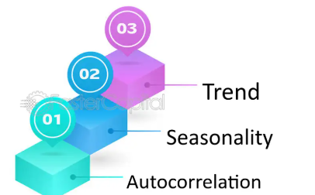


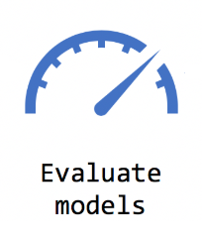

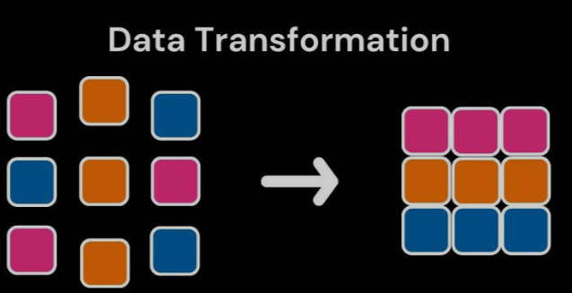

Architecture For Stock Market Analysis
Stationarity

Slide 6
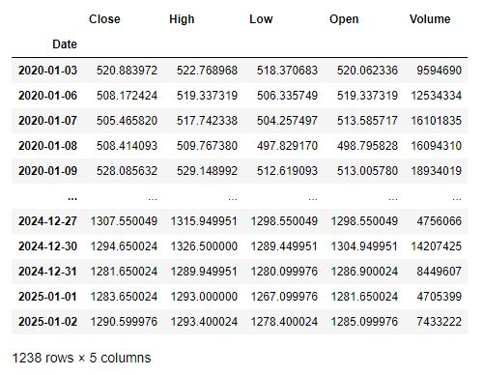
Dataset
The dataset was obtained from Yahoo Finance, focusing on the stock symbol ICICI BANK.NS. Data was extracted using Python libraries such as yfinance for efficient and accurate retrieval.

Slide 7
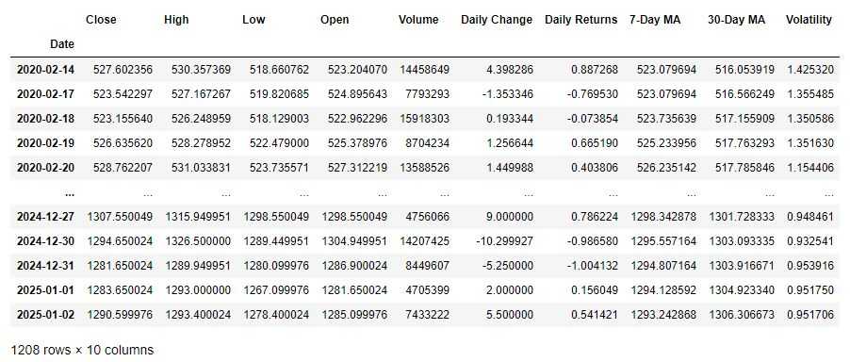
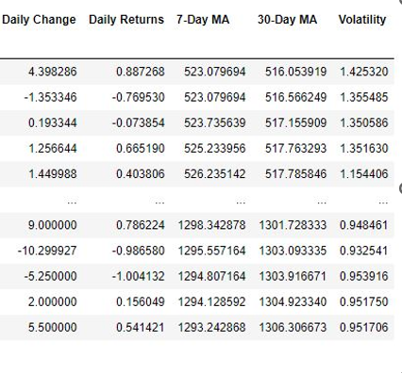
Feature Engineering
We applied feature engineering by calculating metrics such as Daily Change, Daily Returns, Moving Averages, and Volatility using Python libraries like Pandas. This process involved deriving insights from raw data to enhance the forecasting model's accuracy and performance.

Slide 8

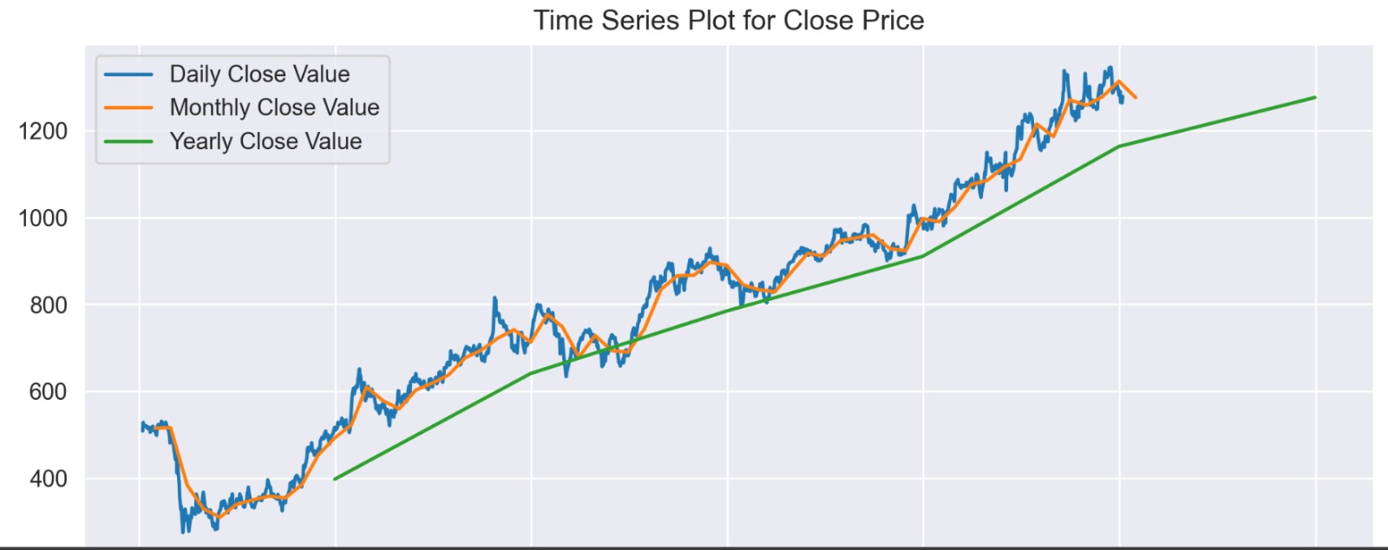
Visualization For Close Price
The plot analyzes stock closing prices at three levels of aggregation:
1. Daily Close Value: Displays detailed daily fluctuations with short-term variations.
2. Monthly Close Value: Smoothed data showing average monthly trends while reducing daily noise.
3. Yearly Close Value: Highlights long-term growth from 2020 to 2025, emphasizing the upward trend.

Slide 9
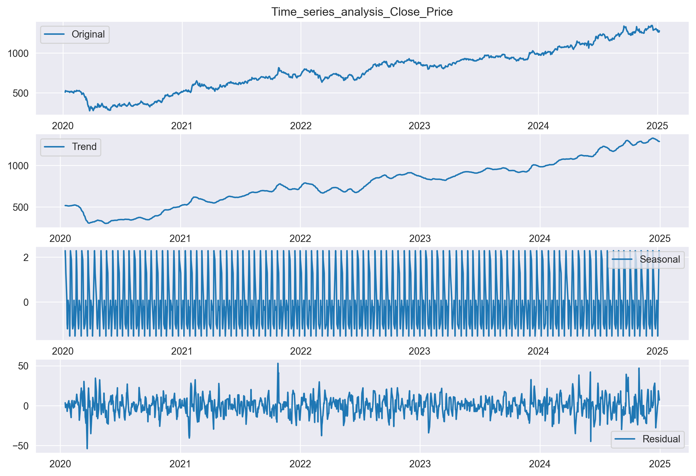
Visualization For Seasonality
The Graph Shows :
The original raw data shows all variations in closing prices over time, including trends, seasonal patterns, and noise.
In Trend, The long-term direction of the data. It shows an overall upward trend in stock prices from 2020 to 2025, smoothing out short-term fluctuations.
In Seasonal, Regular repeating patterns or cycles, such as periodic fluctuations in stock prices, likely reflect seasonal influences or market cycles.
In Residual The remaining noise or irregular variations after removing the trend and seasonal components, represent unpredictable changes.

Slide 10

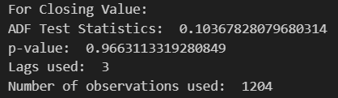

Stationarity
Stationarity in time series refers to a condition where the statistical properties, such as mean, variance, and autocorrelation, remain constant over time. It is a critical assumption for many time series models, as non-stationary data can lead to inaccurate predictions.
According to the p-value, the dataset is non-stationary as the
p-value is more than the alpha value.
Differencing (Close.diff()) to make the "Close" column stationary by removing trends. It creates a new column, close_diff, and removes the resulting NaN values using dropna().
The p-value from the ADF test on close_diff is printed to confirm stationarity; a p-value below 0.05 indicates the data is now suitable for time series modeling like ARIMA.
Non-Stationary
Stationary
According to the p-value, the dataset is now stationary as the p-value is less than the alpha value.

Slide 11
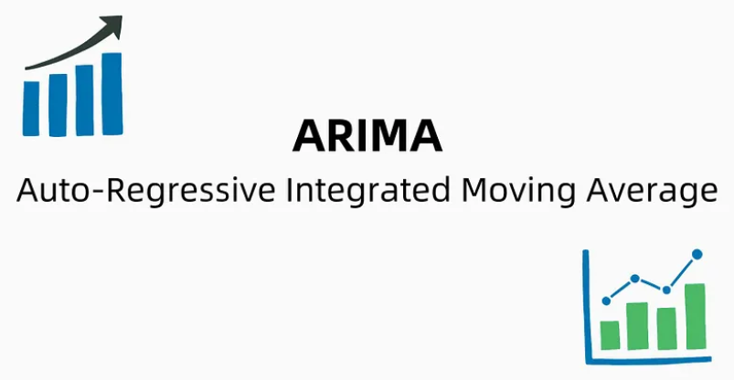

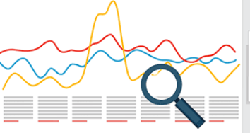
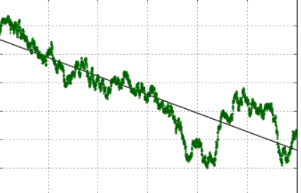
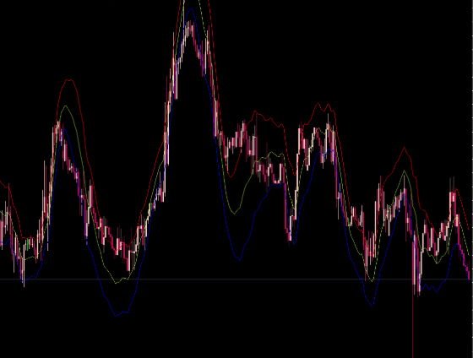
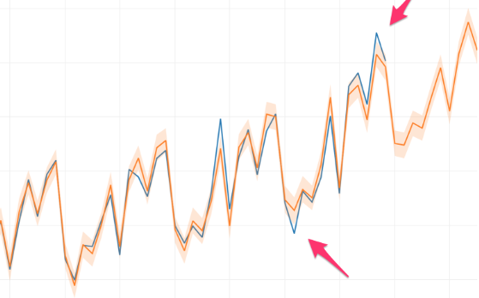
Models
Arima
FB Prophet
Stats Forecast
Linear
Holt’s Winter
Multiplicative Additive

Slide 12
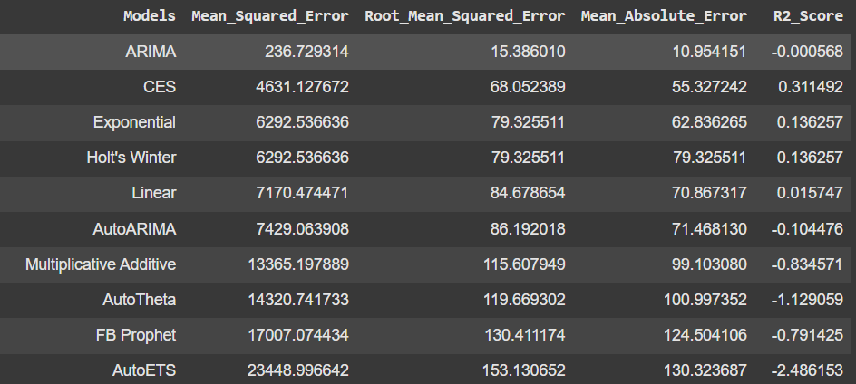
Model Evaluation
Evaluation ensures all the model's reliability in forecasting stock prices. Metrics like MAE, RMSE, and R² assess accuracy and fit.
ARIMA model gives the best accuracy among the other forecasted models.

Slide 13
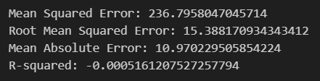
Finalised Model: ARIMA
ARIMA offers accurate, efficient, and reliable forecasting for stock market analysis.
ARIMA for Stock Analysis:
Time Series Focused: Ideal for sequential stock price data.
Captures Trends & Seasonality: Models patterns crucial for stock behavior.
Efficient & Lightweight: Requires less computational power than deep learning models.
Short-Term Accuracy: Excels in short-term forecasts.
Interpretability: Easy to tune and explain predictions.
Proven Reliability: Trusted in financial forecasting for decades.
ARIMA (2, 0, 2) provides
the best accuracy among the forecasted models.
Model Evaluation

Slide 14

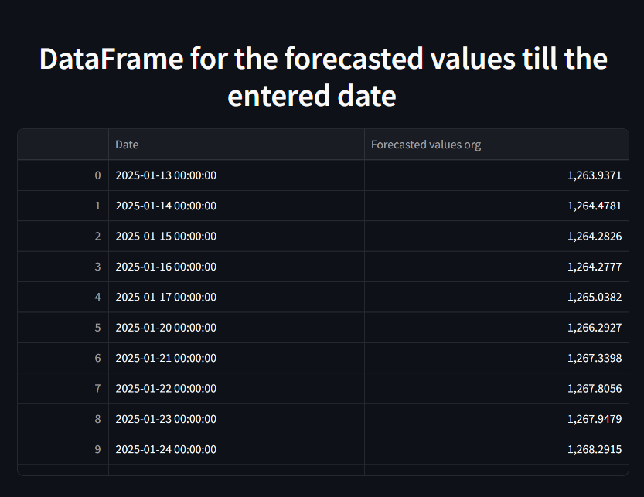
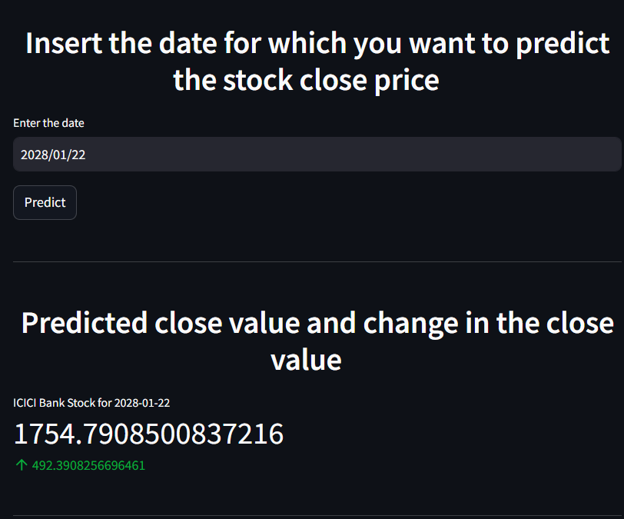
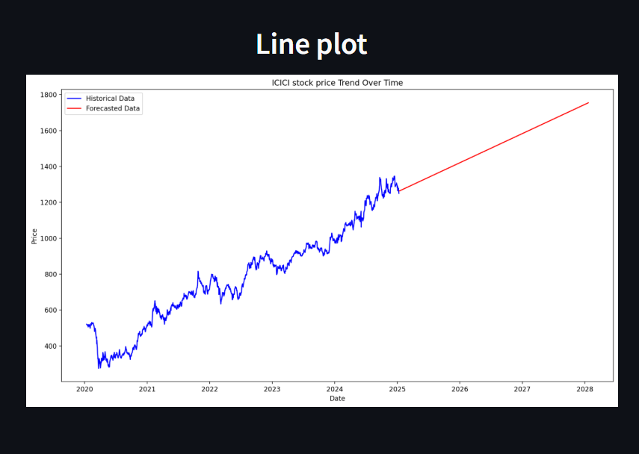
By using the Streamlit framework, we have deployed the ARIMA model and created a web page, So that we can enter a future date to get forecasted stock value and change in the stock along with the graphical and tabular representations.
Deployment

Slide 15
PROBLEMS FACED AND THEIR SOLUTIONS
Extraction of the Data
Extracting updated historical data for the last 5 years from the NSE website was a crucial step.
Solution:
We found the ‘yfinance’ library, which has many methods and functionality using which data extraction becomes easy.
Model Building
There are many models available for forecasting purpose. Finding such different methods was an interesting task for the team.
Solution:
We tried to find some different and new models from internet like ‘FBProphet’ and ‘Statsforecast’ which has multiple functionalities.
Data Transformation
For the finalized ARIMA model data was transformed into stationary format, hence, the model was giving only stationary forecasting.
Solution:
To get the exact values, we again transformed the forecasted data into its original form for accurate predictions.

Slide 16

Thank You

